Slide 1
Alloy surface reactivity

Slide 2
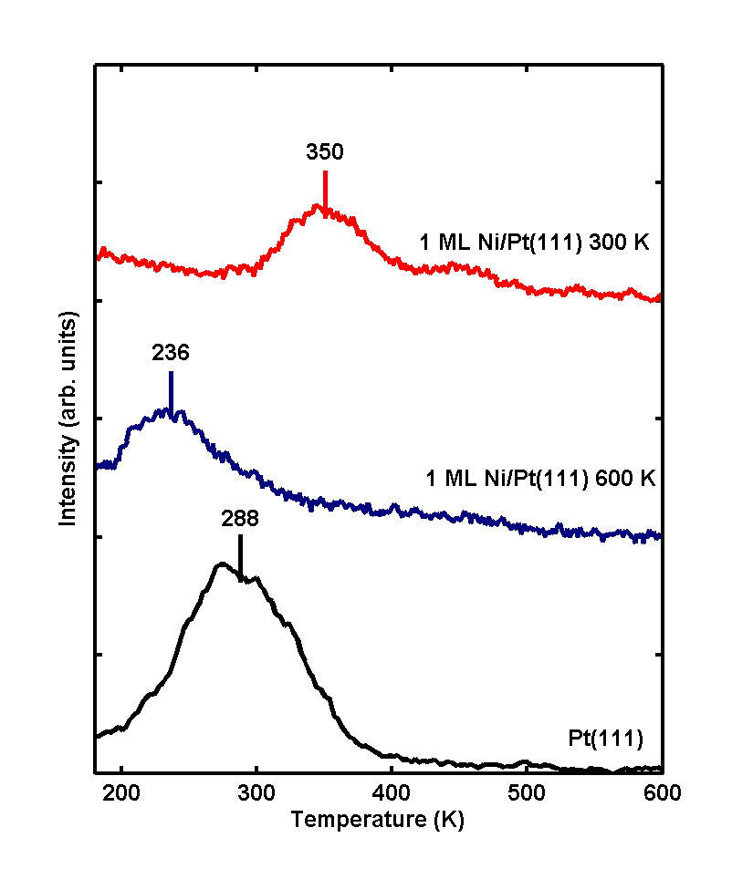
H₂ desorption from Ni/Pt(111) surfaces
Compared to Pt,
H₂ desorbs at a higher temperature from Ni films deposited at 300 K
H₂ desorbs at a lower temperature from Ni films deposited at 600 K
1. Kitchin, J. R. et al. Elucidation of the active surface and origin of the weak metal-hydrogen bond on Ni/Pt(111) bimetallic surfaces: a surface science and density functional theory study. Surface Science 544, 295-308 (2003).

Slide 3
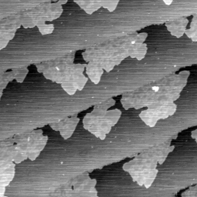
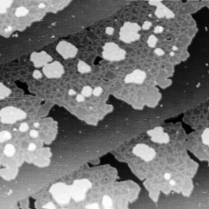
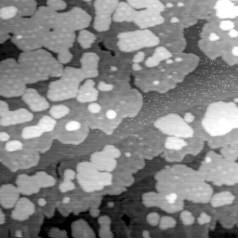
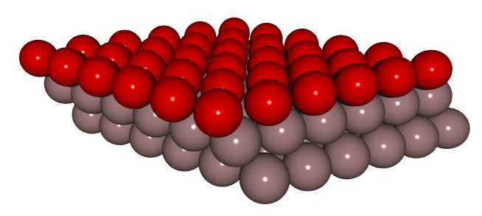
300 K Ni/Pt(111) surfaces
Increasing Ni coverage
Surface Composition:
LEIS: > 90% Ni
Surface Model

Slide 4

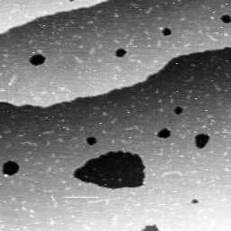
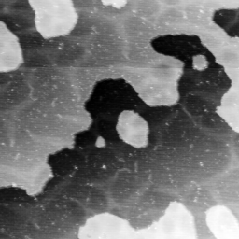
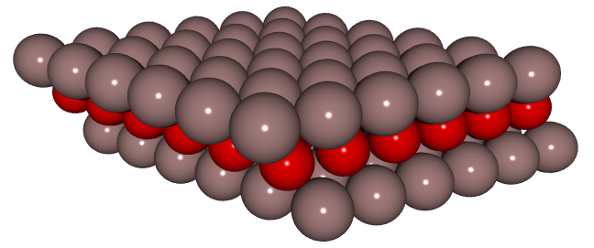
600 K Ni/Pt(111) surfaces
Increasing Ni coverage
Surface Composition:
LEIS: > 60% Pt
Can these physical structure differences explain the different adsorption properties?

Slide 5
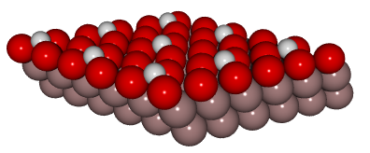
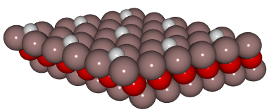
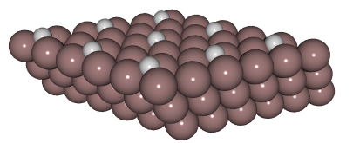
Calculated adsorption energies
Calculated
ΔH_{diss. ads.}
-1.40 eV
-0.64 eV
-0.88 eV
The different structures are one explanation for the different chemical properties

Slide 6
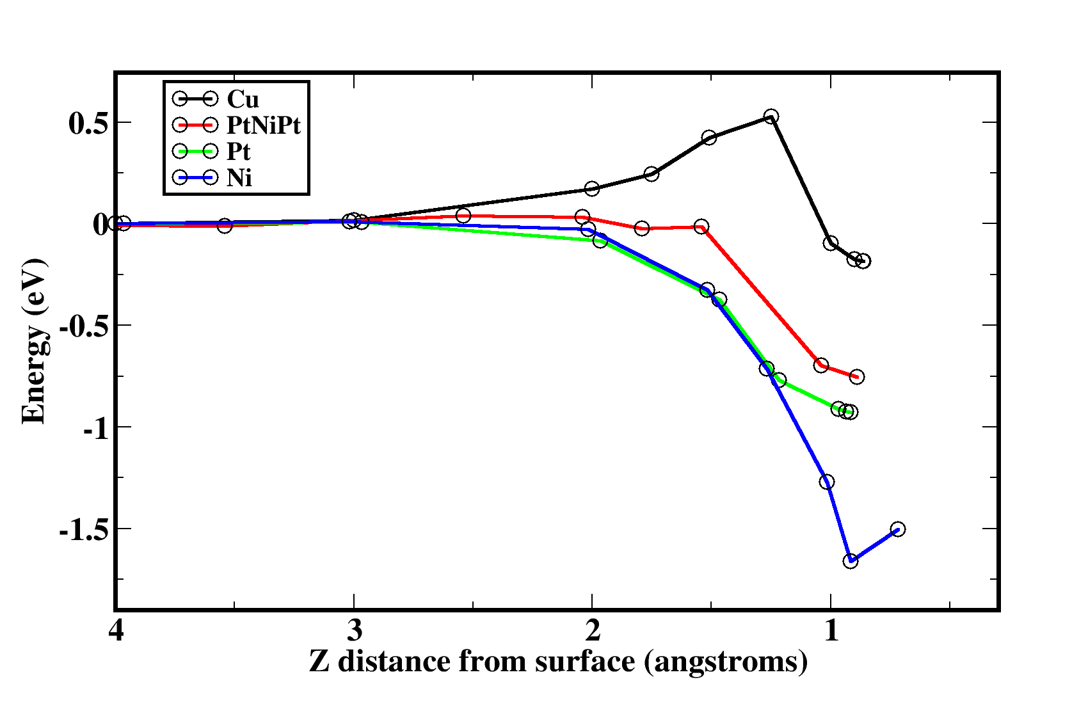
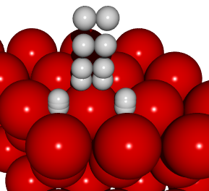
Is H₂ dissociation activated?
No, but other Pt-3d surfaces may be.

Slide 7

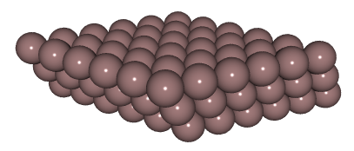
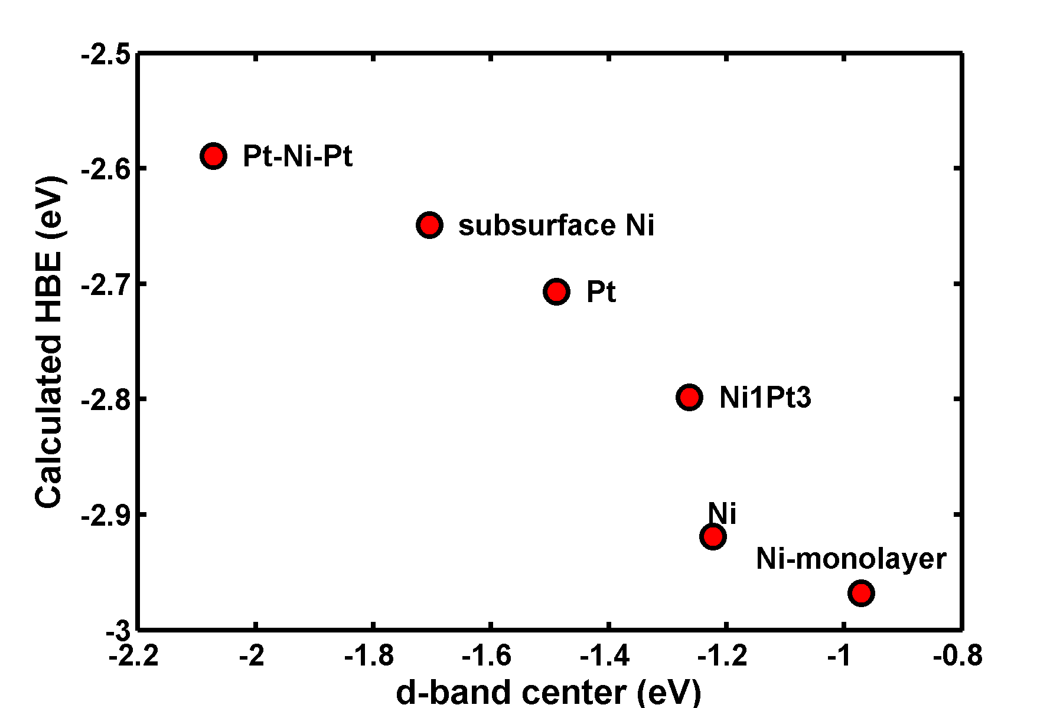
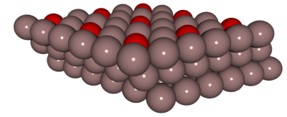

Theoretical calculations of H adsorption energies
T_{d} = 236 K
T_{d} = 288 K
weaker
stronger
T_{d} = 350 K
Subsurface Ni is most likely responsible for the weak HBE!

Slide 8
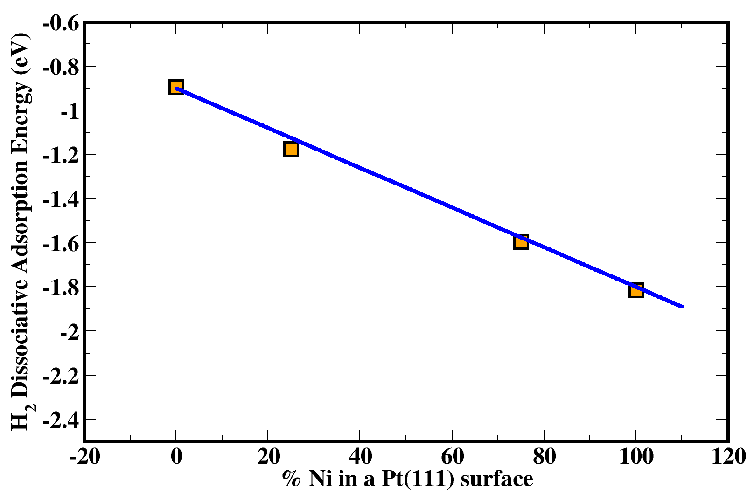


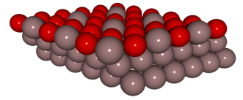

Interpolation of active site properties
Ensemble effects tend to give intermediate adsorption energies

Slide 9
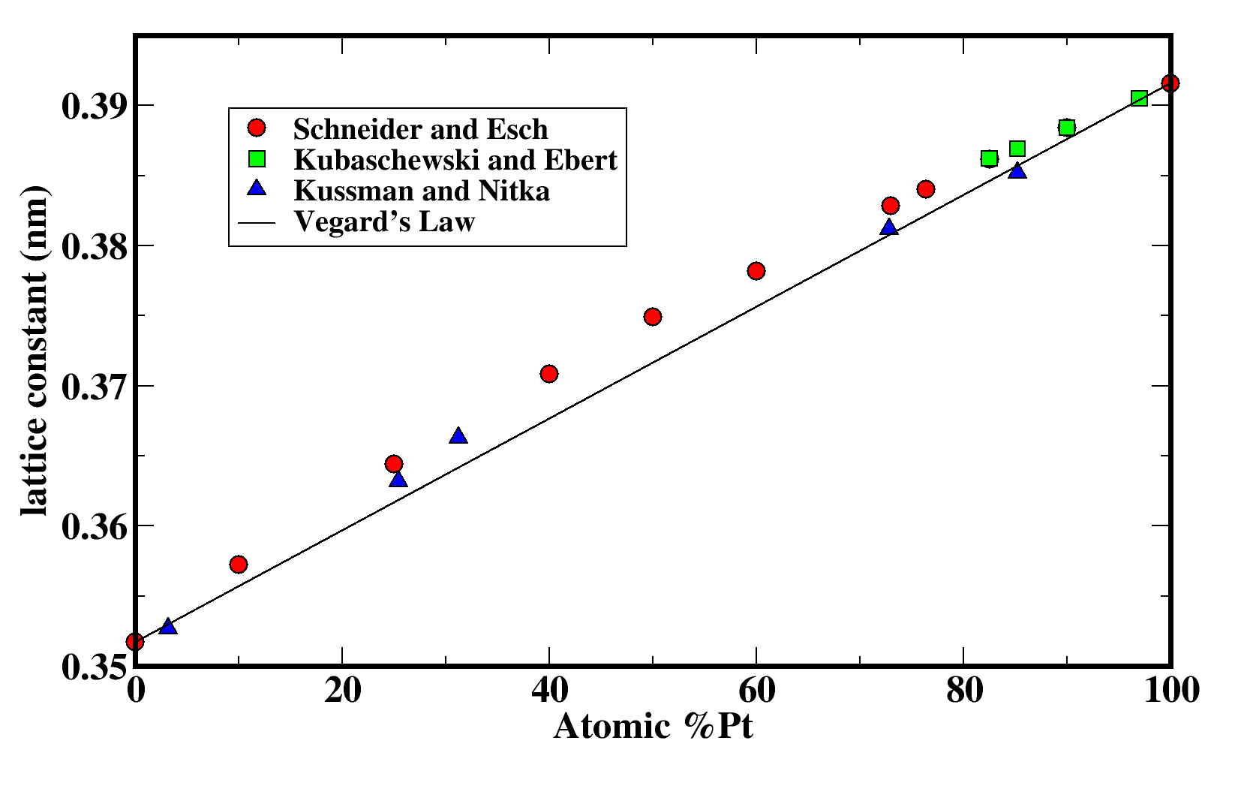
Ni/Pt lattice constant variation
Pt is compressively strained
Ni is tensile strained
Near linear variation of lattice constant with composition

Slide 10
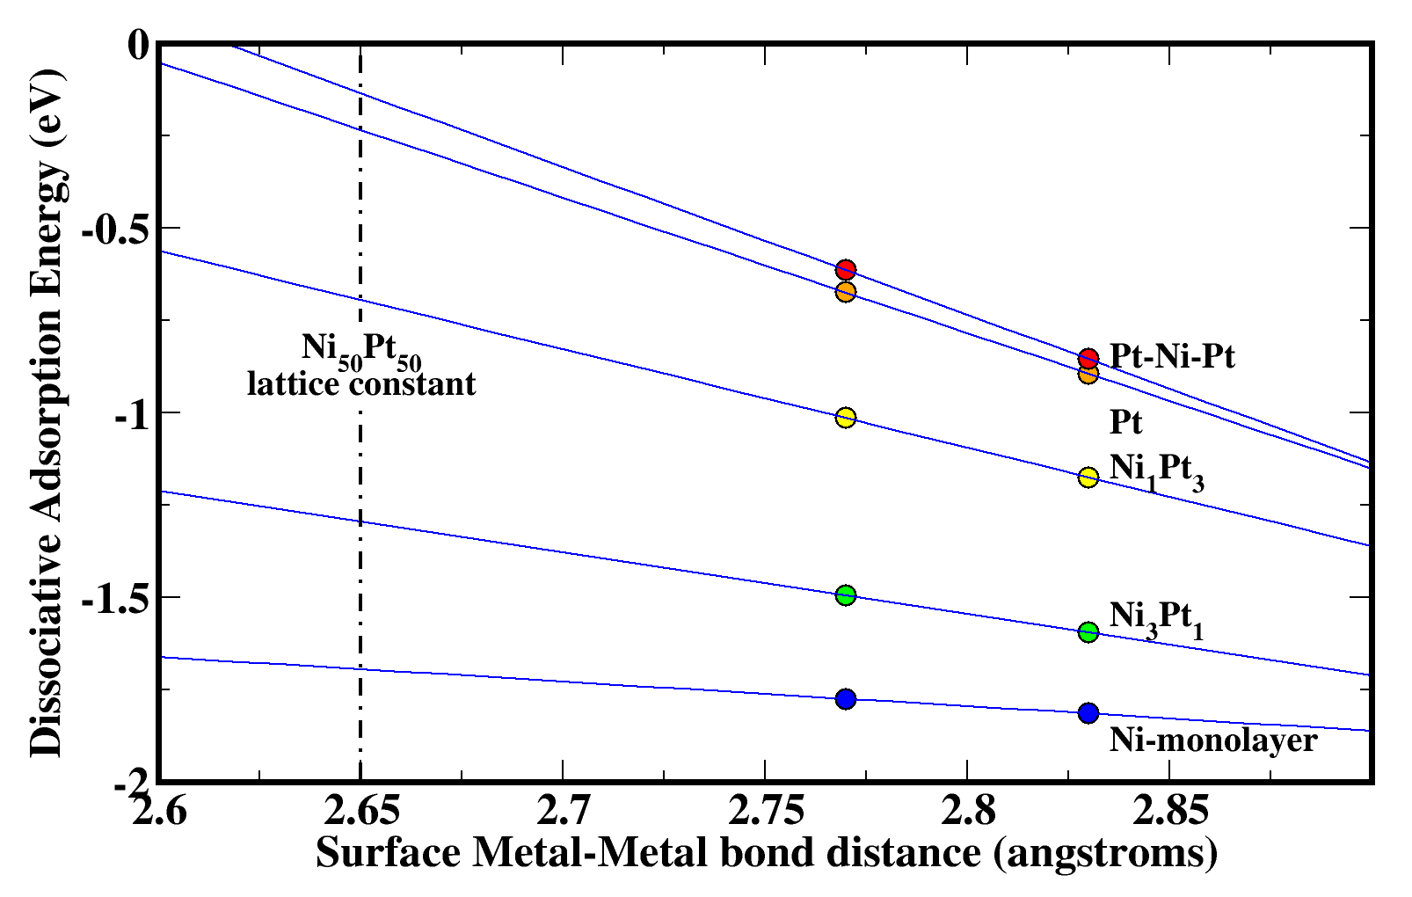
The effect of strain
Compressive strain = weaker bonds
Tensile strain = stronger bonds
Strain does not change the trend

Slide 11
Mechanisms for modification
Ligand effect
Ensemble effect
weaker
stronger
Strain effect
Three ways to tune the chemical properties!

Slide 12
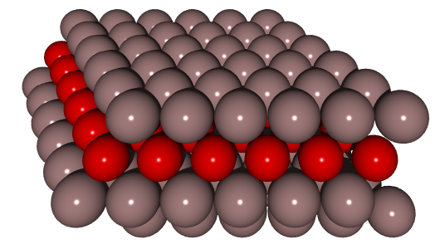
Pt-3d bimetallic surfaces
Fuel cell electrocatalysts
Selective hydrogenation
Ti
V
Cr
Mn
Fe
Co
Ni
Cu
Zr
Nb
Mo
Tc
Ru
Rh
Pd
Ag
Hf
Ta
W
Re
Os
Ir
Pt
Au
Use theory to rapidly screen new systems
Strain-free surfaces
Isolate the ligand effect
Compare idealized surface with experiments

Slide 13
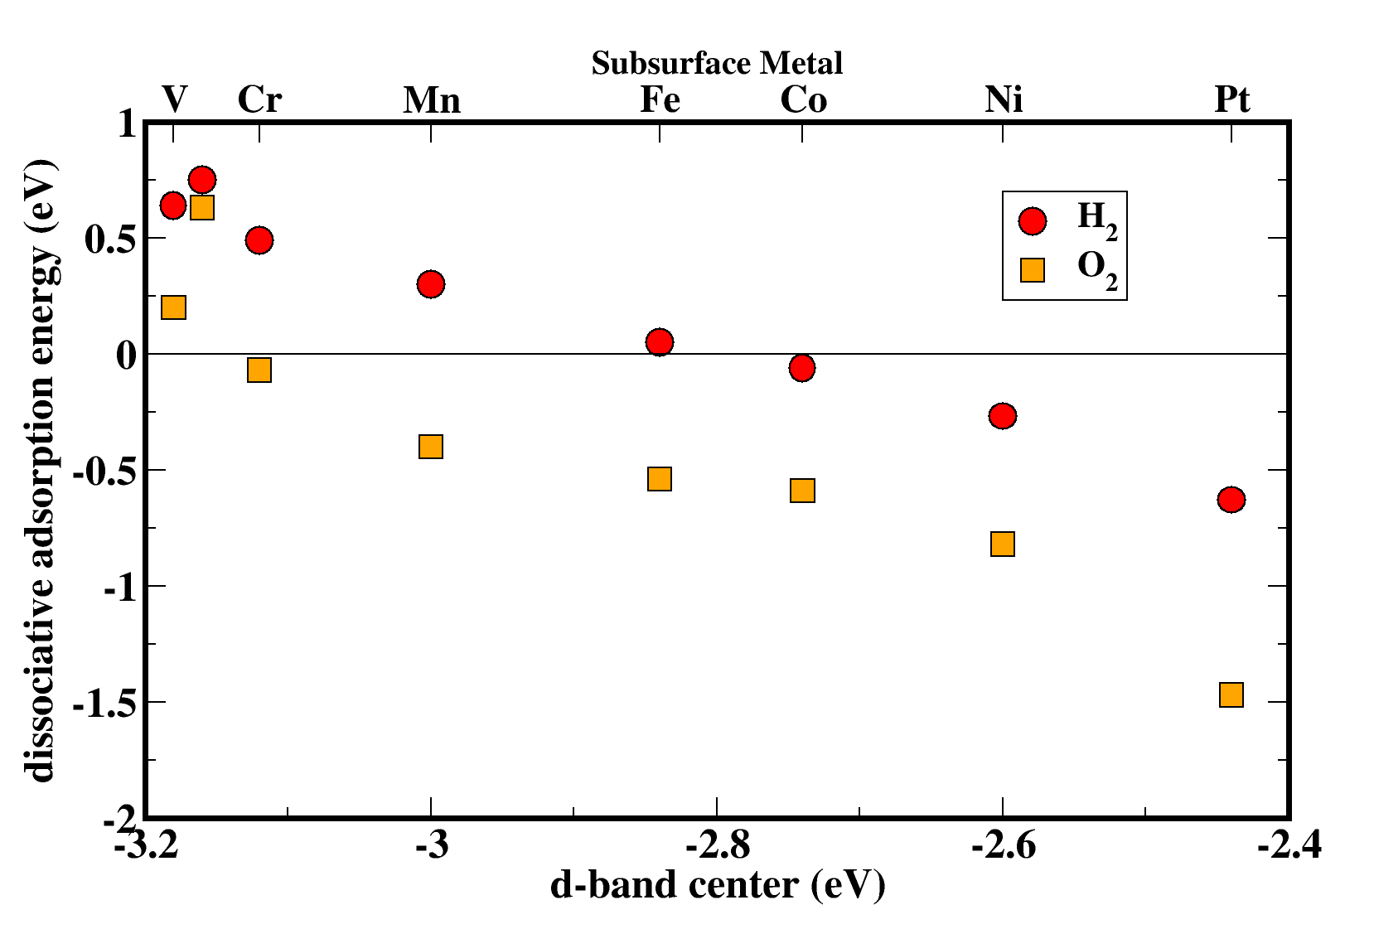
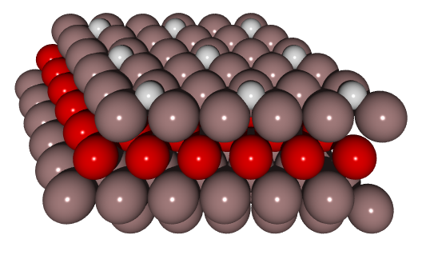
H₂ and O₂ adsorption on Pt-3d surfaces
Ti
V
Cr
Mn
Fe
Co
Ni
Pt
Ni has the smallest effect!
Same trend for H₂ and O₂
Experimental verification for subsurface Ni, Co, Fe, Ti
1. Kitchin, J. R., Nørskov, J. K., Barteau, M. A. & Chen, J. G. Modification of the surface electronic and chemical properties of Pt(111) by subsurface 3d transition metals. Journal of Chemical Physics 120, 10240-10246 (2004).

Slide 14
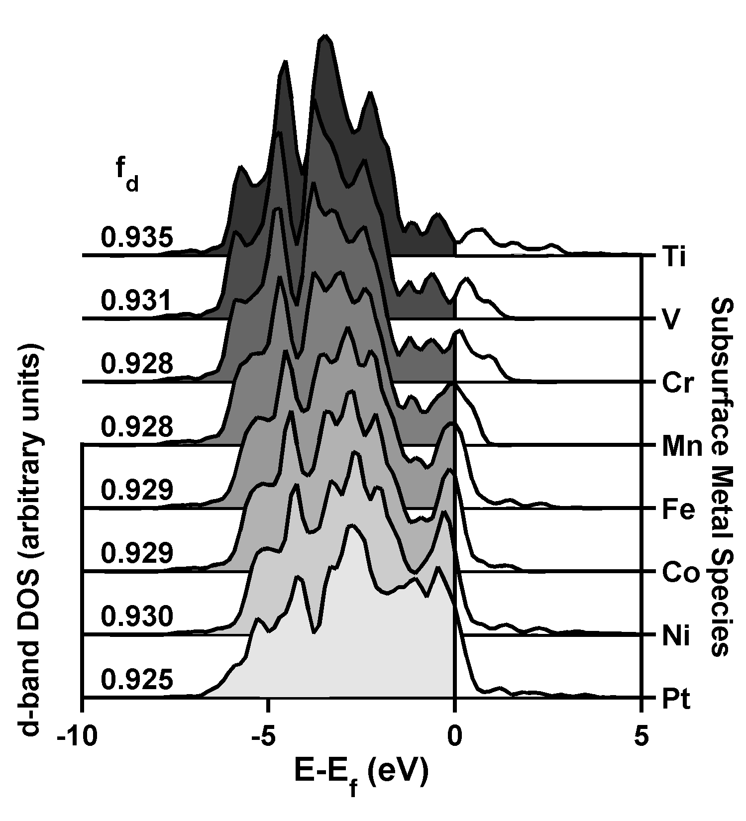
Pt d-band modification
The Pt surface d-band is broadened by subsurface 3d metals
The d-DOS at the Fermi Level decreases
The Pt d-band filling stays constant

Slide 15
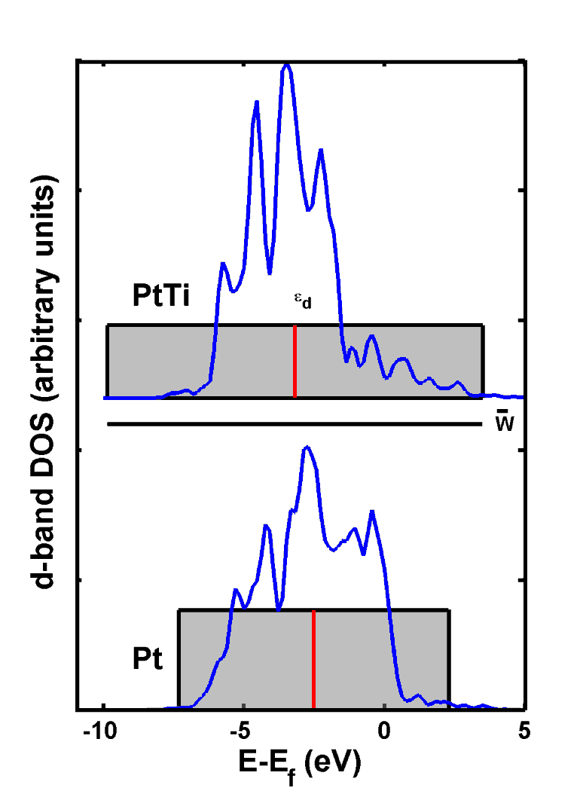
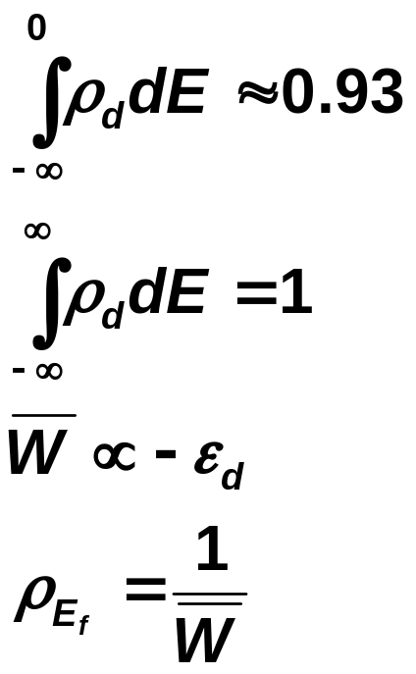
Rectangular band model

Slide 16
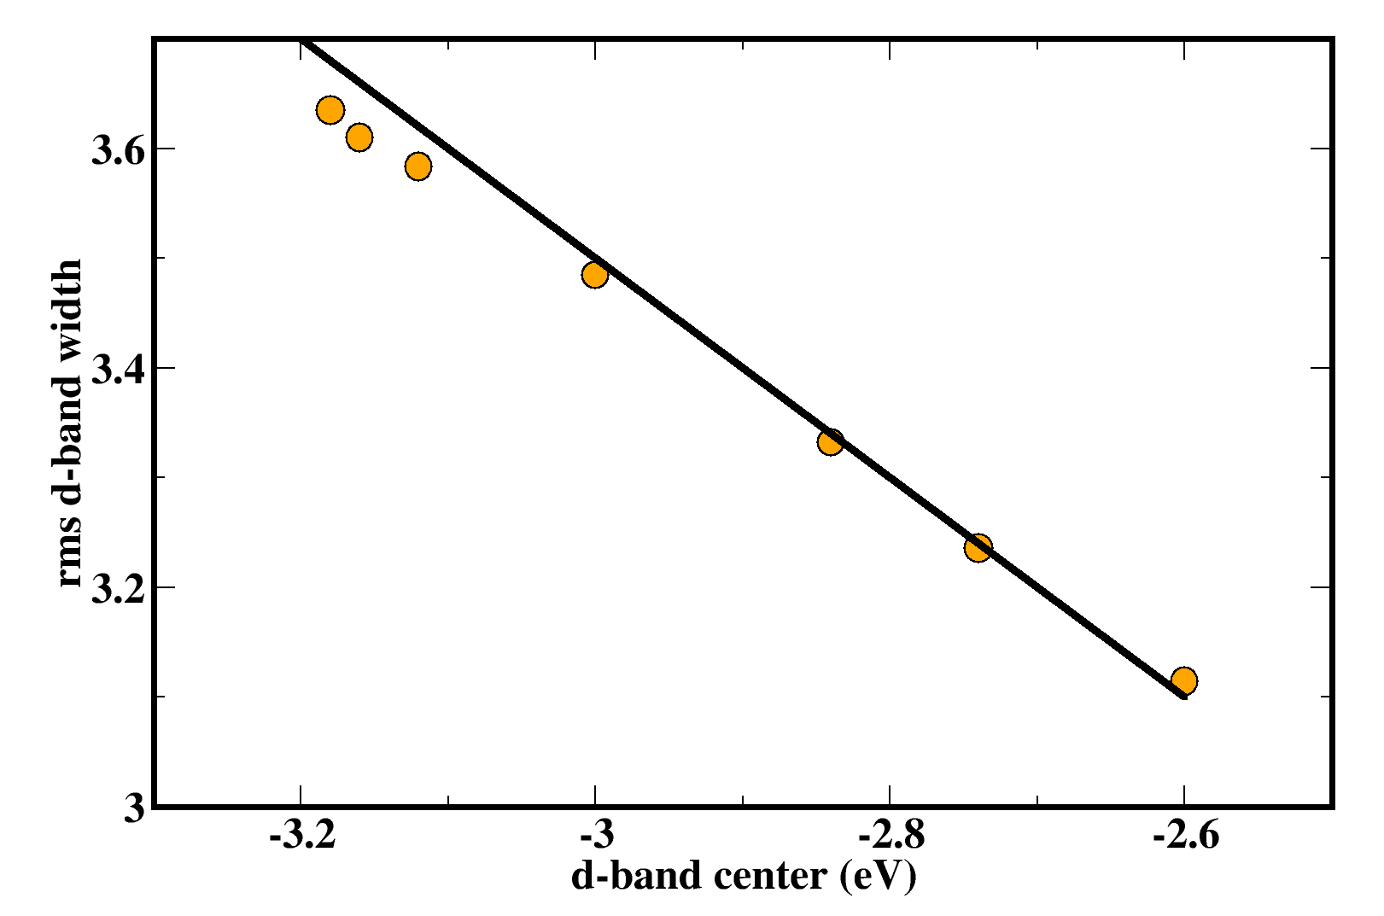
d-band width vs. d-band center
slope=-1
The rectangular band model explains the behavior of real bands!

Slide 17
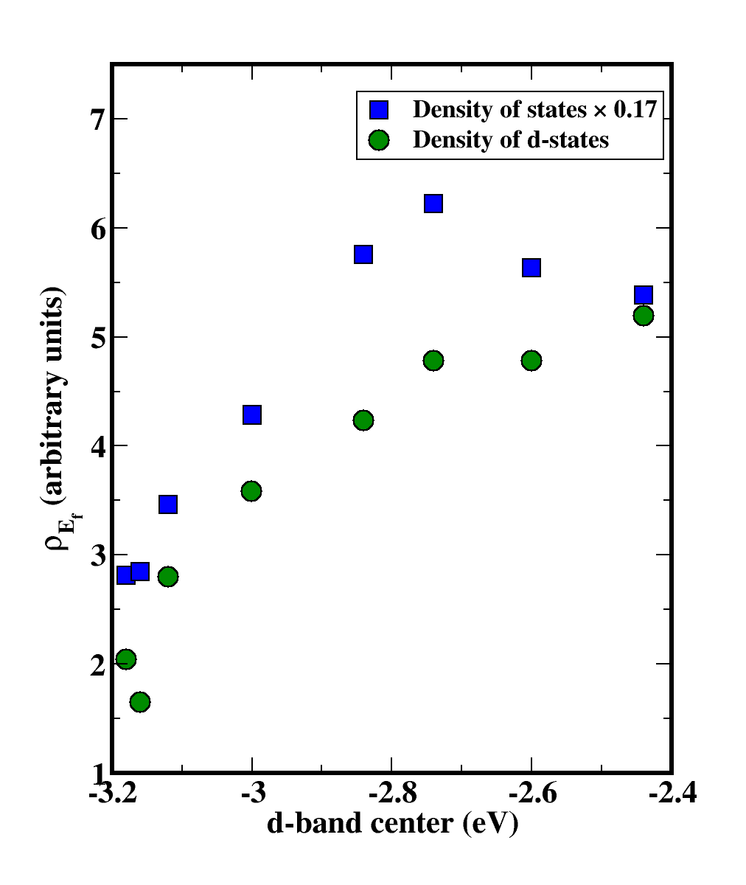
DOS at Fermi Level

Slide 18
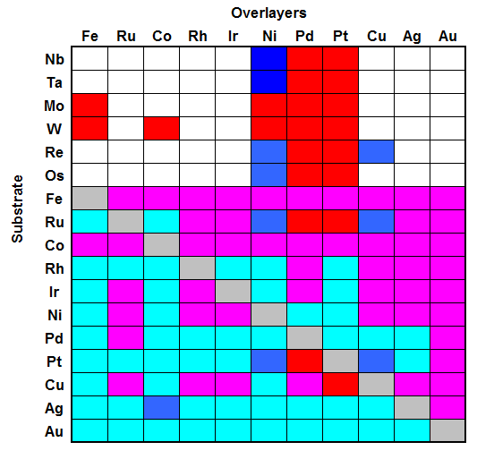
Growing database of d-band center shifts
This work
Literature
Positive shift ⇒ Stronger adsorbate bonds
This work
Literature
Negative shift ⇒ Weaker adsorbate bonds
Starting point for rational bimetallic catalyst design.

Slide 19
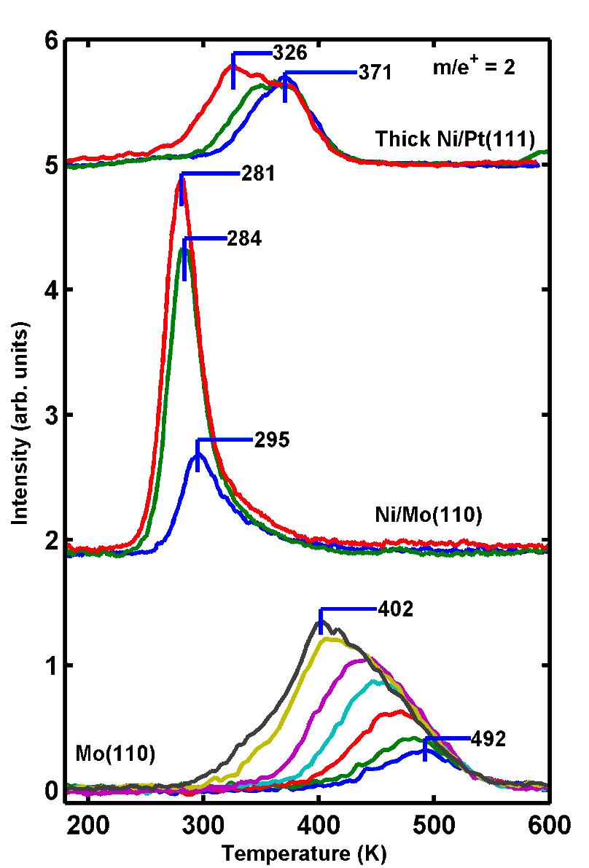
H₂ adsorption on Ni/Mo(110)
H₂ adsorbs more weakly to Ni/Mo(110) than Ni(111)
Predictions also verified for
  Pd/Mo(110)
  Ni/W(110)
  Ni/Ru(001)
  Co/Pt(111)

Slide 20
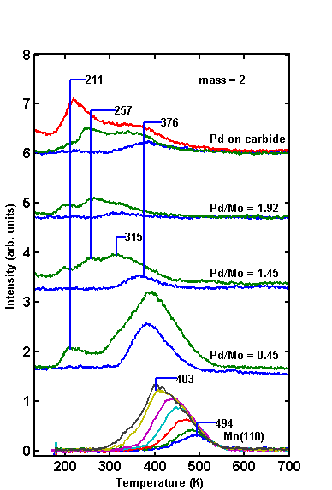
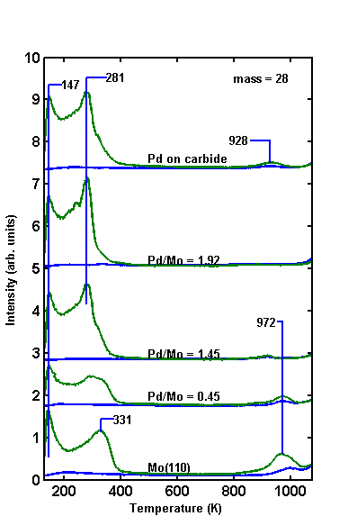
Pd/Mo(110)
Hydrogen
CO

Slide 21
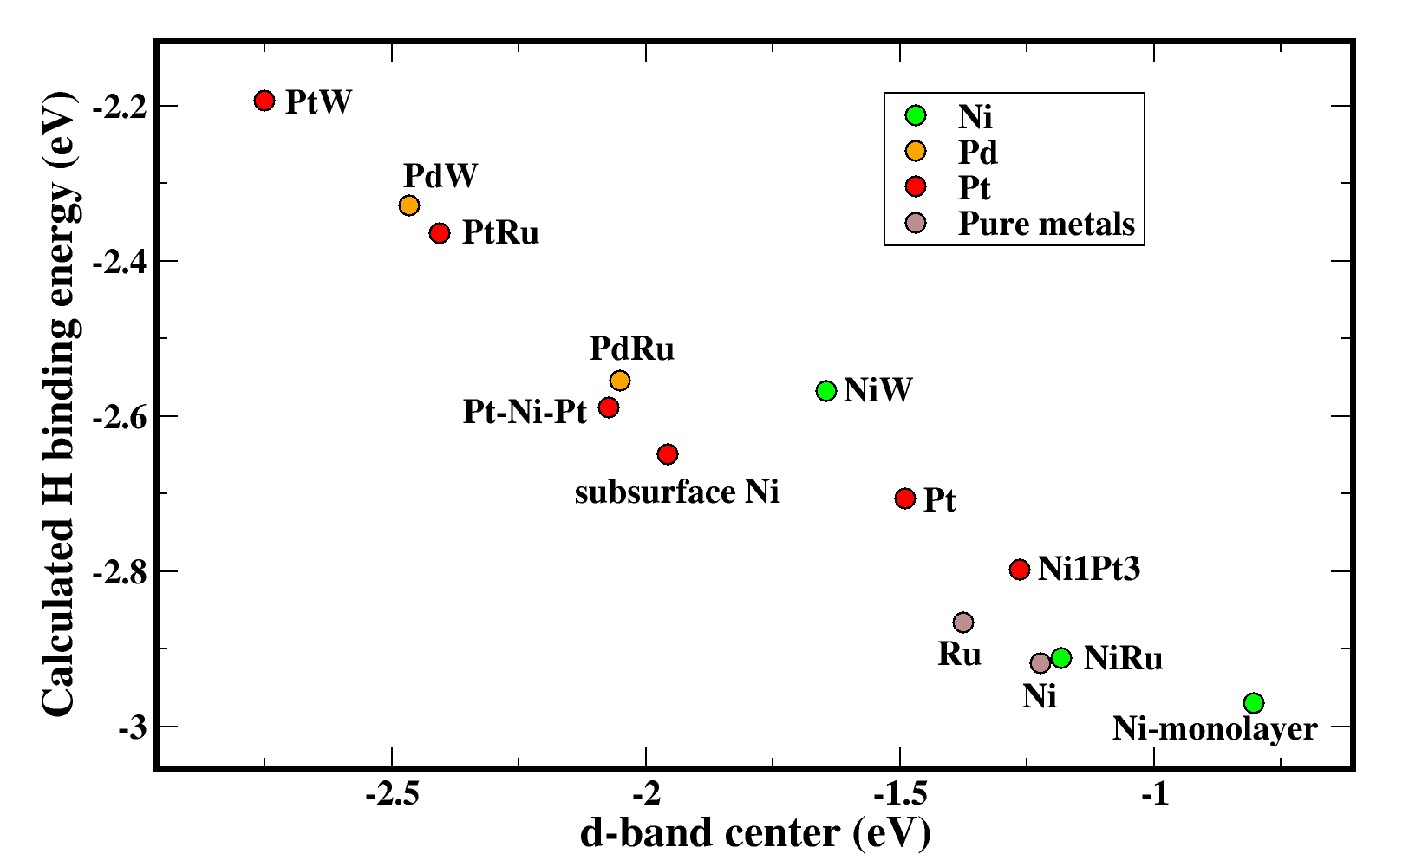
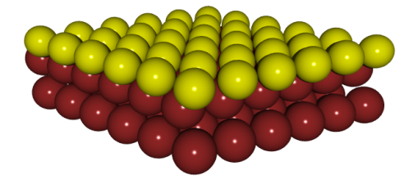
H adsorption on bimetallic monolayers
Similar trends for:
Carbon monoxide
Nitrogen
Ethylene
Acetic acid
Maleic anhydride
Reaction barriers
…
The d-band center is an excellent indicator for chemical properties of bimetallic surfaces!

Slide 22
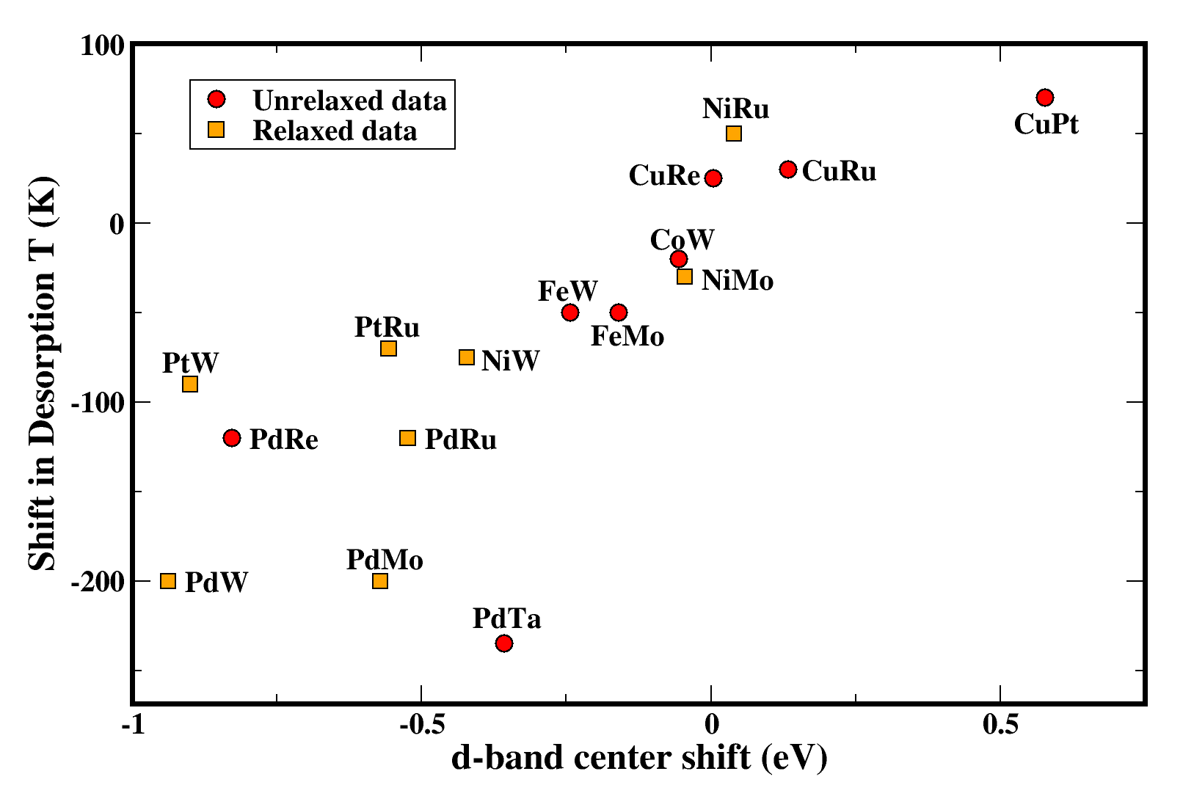
CO desorption
An experimental/theoretical correlation
Shifting the d-band center to more negative values decreases the CO adsorption energy ⇒ lower CO coverage. BUT…

Slide 23
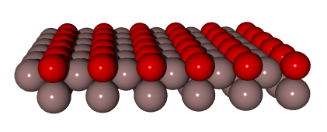
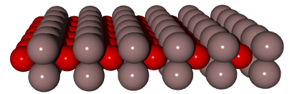
Which surface is more stable?
Ni/Pt alloys
Ni Segregation
Pt Segregation
(111)
(110)
Segregation Energy (eV/Ni atom)
Bimetallic System
Ni/Pt(111)
-0.65
Ni/Pt(111) +¼ monolayer O
-0.05
Ni/Pt(110)
+0.36

Slide 24
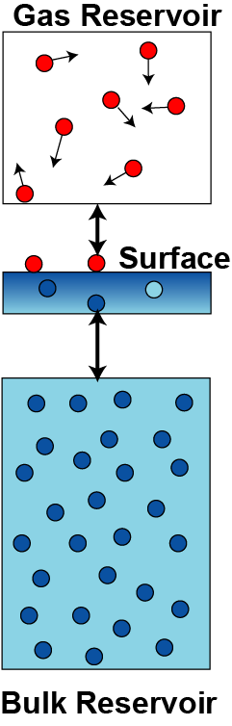
Alloy surface stability
Factors that affect surface stability
Bulk alloy formation
Surface formation
Segregation
Adsorption
In the thermodynamic sense, the most probable surface at some temperature and pressure is the one that minimizes the Gibbs surface free energy under those conditions.

Slide 25
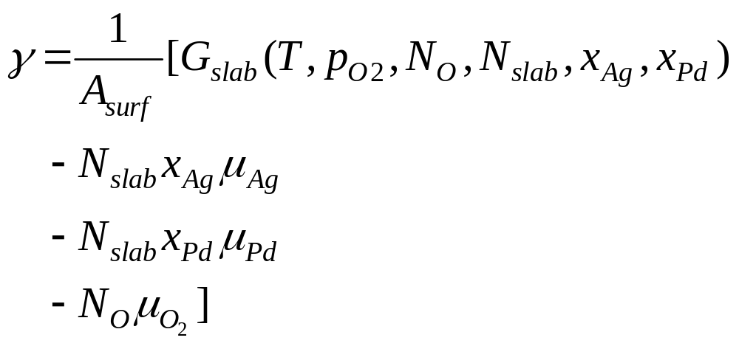
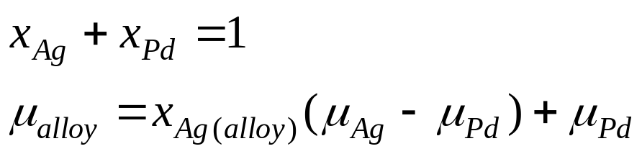
Alloy surface stability
Thermodynamic definition of surface free energy
Constraints:
Bulk alloy formation
Kitchin, Reuter, Scheffler Phys. Rev. B 77, 075437 (2008)

Slide 26
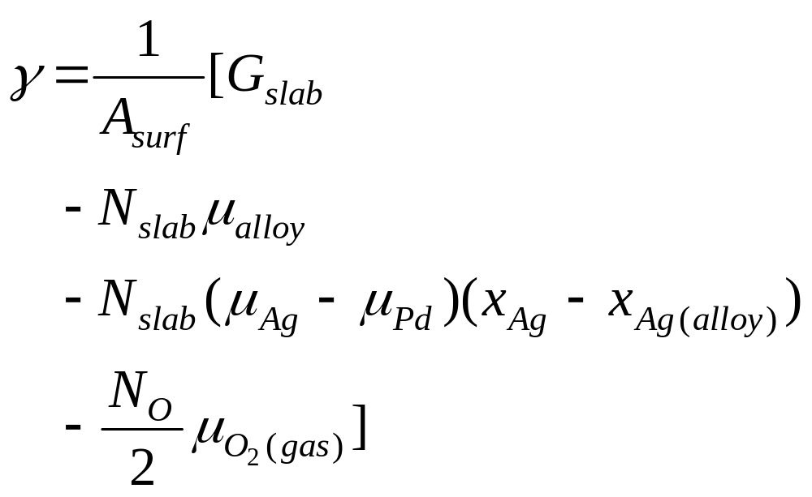
With the two constraints we derive the new equation:
Slab energy
Surface formation
Segregation
Adsorption

Slide 27
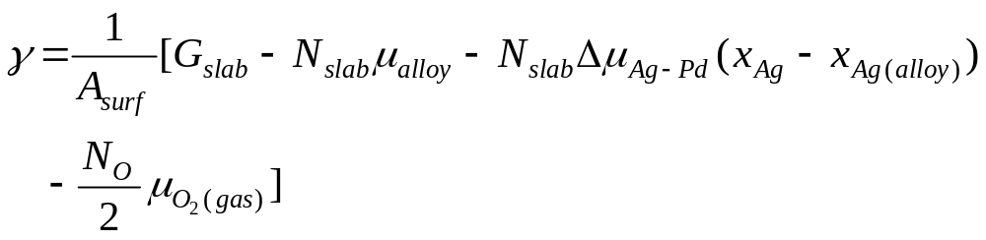
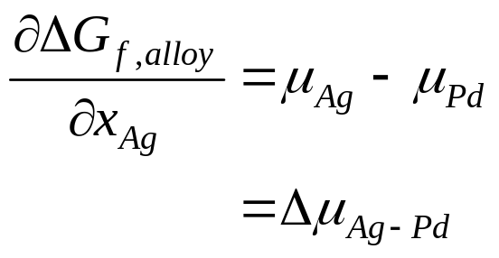

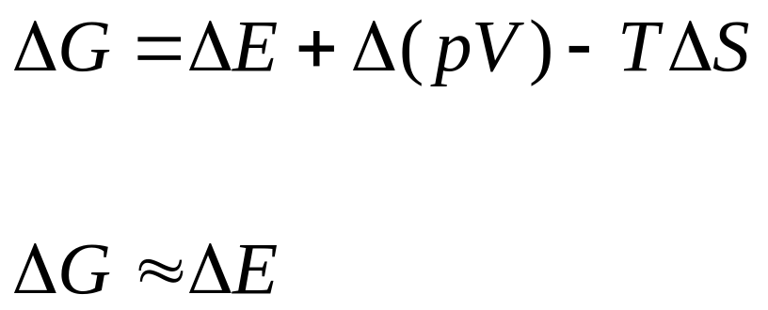
Dependence of  on the bulk alloy
Thermodynamics → DFT
Small for solids
Δ(Vibrational entropy) is small
Neglect configurational entropy
We can approximate ΔG by ΔE calculated from DFT

Slide 28

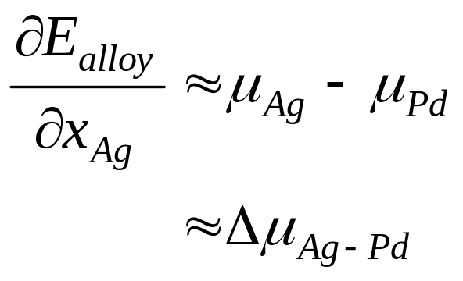
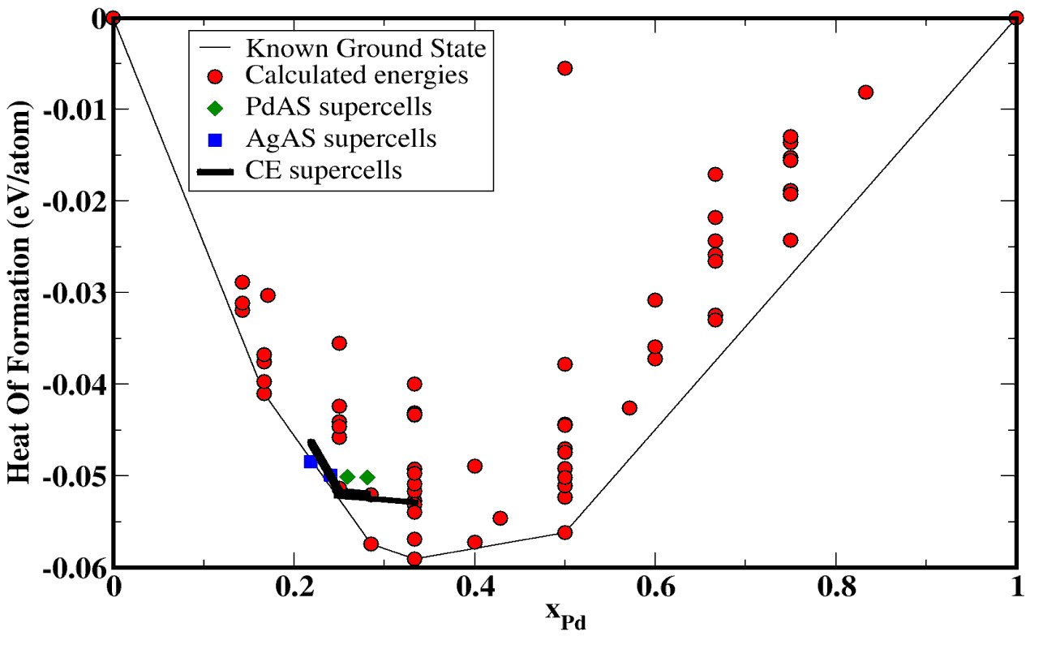
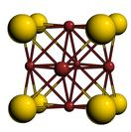

Dependence of  on bulk alloy
Ag_{x}Pd_{1-x} bulk phase diagram (DFT)
We calculate both these quantities from the bulk phase diagram
Ag-rich
Pd-rich

Slide 29
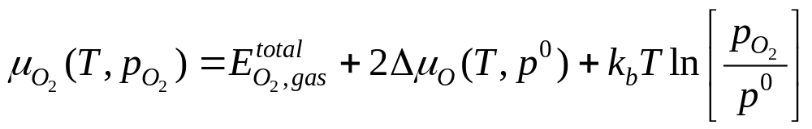
Dependence of  on gas phase conditions
Defined by the reactive environment
Total
energy
Tabulated from experimental data

Slide 30
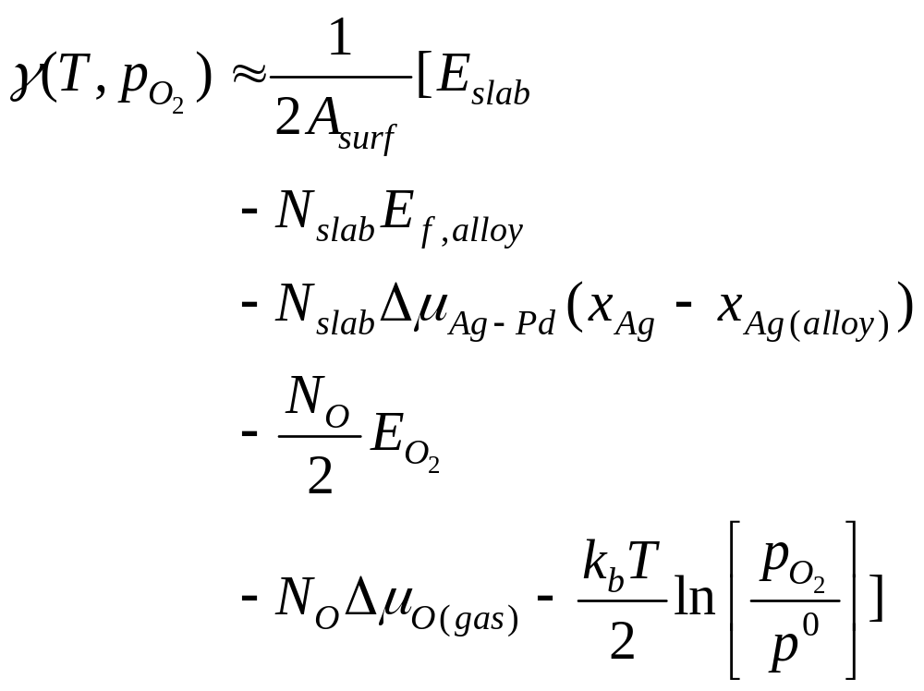
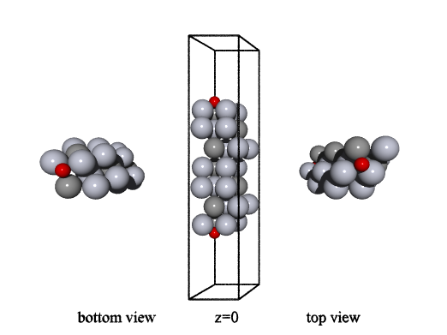

Slab models of alloy surfaces
We calculate  for many surface models to identify the lowest energy surface configurations for a given T and p_{O2}

Slide 31
Computational details
Dacapo (Ultrasoft pseudopotentials)
PBE GGA XC functional
7 layer inversion-symmetric slabs, inner 3 layers frozen at bulk lattice constant, 4 atoms/layer
14 Å vacuum
No symmetry constraints
350 eV cutoff, 8×8×1 Monkhorst-Pack kpt grid in 2×2 surface unit cells
More than 450 surface models were considered
Ag₃Pd in the L12 crystal structure was the bulk alloy
Oxygen was dissociatively adsorbed on 3-fold sites
Kitchin, Reuter, Scheffler Phys. Rev. B 77, 075437 (2008)

Slide 32

Segregation in Pd-rich alloys
Ag_{3-x}Pd_{1+x}
A small excess of Pd atoms exist (Pd anti-sites)
At low oxygen pressure the surface is Ag-terminated
Pd segregates to the surface as soon as adsorption is favorable

Slide 33

Segregation in Ag-rich alloys
Ag_{3+x}Pd_{1-x}
A small excess of Ag atoms exist (Ag anti-sites)
At low oxygen pressure the surface is Ag-terminated
A higher oxygen pressure is required to induce Pd-segregation

Slide 34







Segregation in vacuum
Cost in energy to change the surface composition
Clean surface energy (vacuum)
Incorporation of Pd into the surface is thermodynamically unfavorable under vacuum conditions
-0.1 to 0.6 eV/atom range
Surface energy is not a simple function of surface composition

Slide 35




Adsorption energy trends:
Coverage effects
Palladium
Silver
Oxygen
Variations at each coverage due to 2nd layer composition
~1 eV range in ΔH_{ads} due to coverage effects
Endothermic adsorption
ΔE_{seg} = -0.1 - +0.6 eV/atom
H_{ads} = 0.0 to -1.5 eV/O

Slide 36




Conclusions I
Simple methodology for examining segregation behavior in alloys including the effect of reactive environments
Segregation in reactive environments determined by competing effects: lowering surface energy and strong adsorbate bonding
Coverage effects on Ag and Pd-terminated surfaces are not the same
Oxygen induces a segregation reversal in Ag₃Pd(111) compared to vacuum
Vacuum
Oxygen
Bulk
Bulk
Kitchin, Reuter, Scheffler Phys. Rev. B 77, 075437 (2008)

